Slide 1
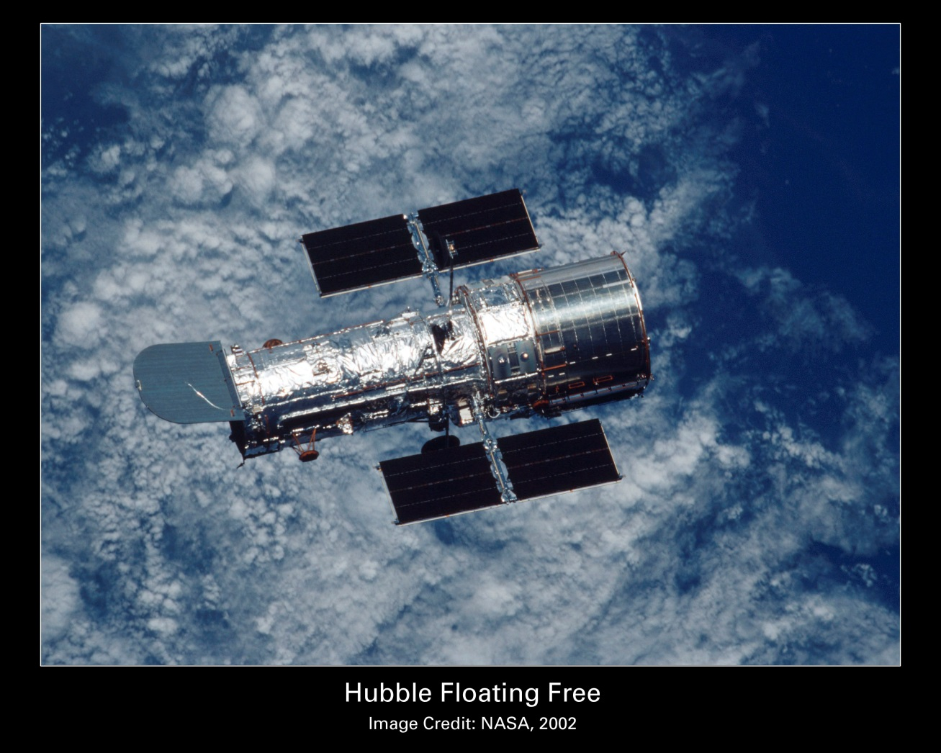
EE370 Lab
Final Project Presentation:
Hubble Space Telescope Damping System

Slide 2
This project is based on problem 10.47 from the class’s textbook.
When the Hubble telescope is on the “daytime” side of the Earth, or when it transitions from darkness into sunlight, there are oscillations that occur at two distinct frequencies. These oscillations are deleterious to crisp observation of the Universe.
A compensator is proposed to reduce the effect of these oscillations when placed in cascade with the telescope’s directional control system. The transfer function of the compensator is:
$$G_{c}\left(s\right)=\frac{1.96(s^{2}+s+0.25)(s^{2}+1.26s+9.87)}{(s^{2}+0.015s+0.57)(s^{2}+0.083s+17.2)}$$

Slide 3
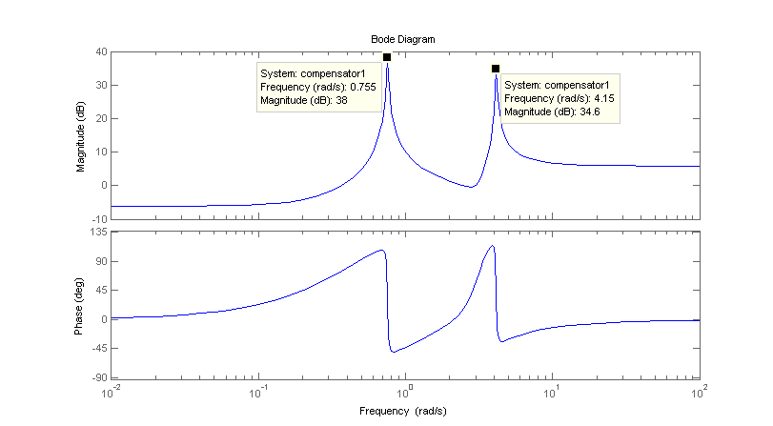
Frequency Response of Compensator
MATLAB is an easy way to obtain the frequency response of the compensator:

Slide 4
Effect of Compensator in feedback loop
In order to understand how the compensator damps the frequencies of the “Thermal Flutter” we need to derive the closed loop transfer function to determine how the disturbance affects the output.
Here is the block diagram of the system:
We can derive the output in terms of
the input and the feedback:
Y = DG_{p} + (R – Y)G_{c}GG_{p}
Y(1 + G_{c}GG_{p}) = RG_{c}GG_{p}+ DG_{p}
$$Y= R\frac{G_{c}GG_{p}}{1+ G_{c}GG_{p}}+D\frac{G_{p}}{1+ G_{c}GG_{p}}$$

Slide 5
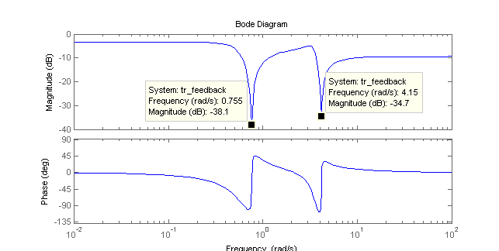
Regardless of the specific transfer functions of the controller and plant, the large magnitude response of the compensator at the two frequencies will damp those frequencies. Two examples are presented, one with unity transfer functions for both the controller and plant, and one with:
$$G\left(s\right)=\frac{8}{s+8} G_{p}\left(s\right)=\frac{125}{s^{2}+s+125}$$
Frequency Response 1

Slide 6
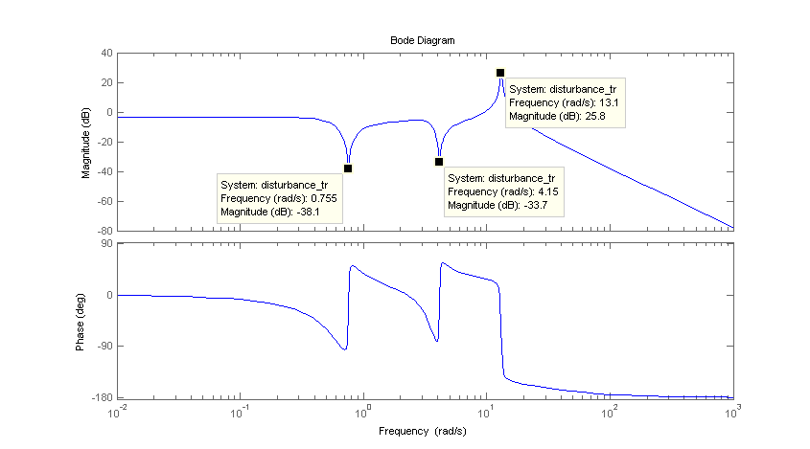
Frequency Response 2 (non-unity controller and plant TF)

Slide 7
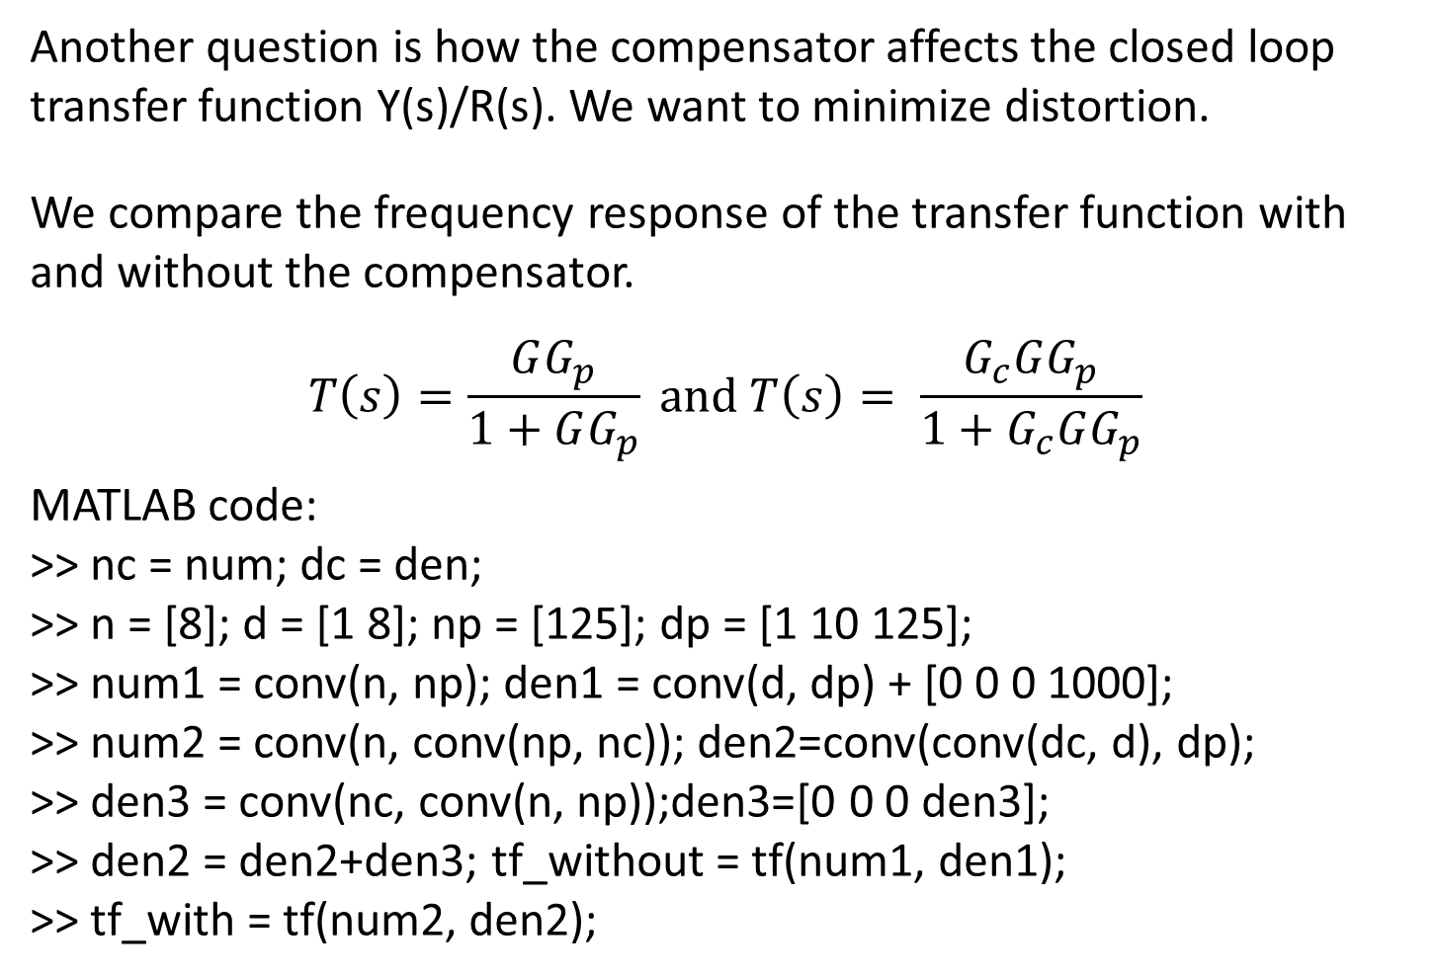
Effect of compensator on transfer function Y(s)/R(s)
Another question is how the compensator affects the closed loop transfer function Y(s)/R(s). We want to minimize distortion.
We compare the frequency response of the transfer function with and without the compensator.
$$T\left(s\right)=\frac{GG_{p}}{1+GG_{p}} and T\left(s\right)= \frac{G_{c}GG_{p}}{1+G_{c}GG_{p}}$$
MATLAB code:
>> nc = num; dc = den;
>> n = [8]; d = [1 8]; np = [125]; dp = [1 10 125];
>> num1 = conv(n, np); den1 = conv(d, dp) + [0 0 0 1000];
>> num2 = conv(n, conv(np, nc)); den2=conv(conv(dc, d), dp);
>> den3 = conv(nc, conv(n, np));den3=[0 0 0 den3];
>> den2 = den2+den3; tf_without = tf(num1, den1);
>> tf_with = tf(num2, den2);

Slide 8
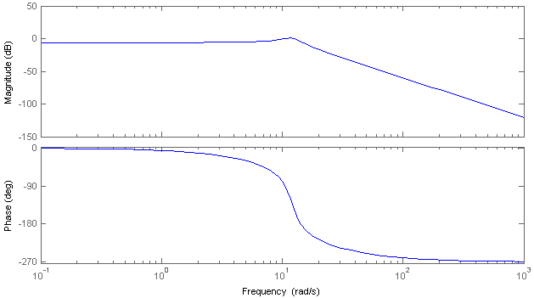
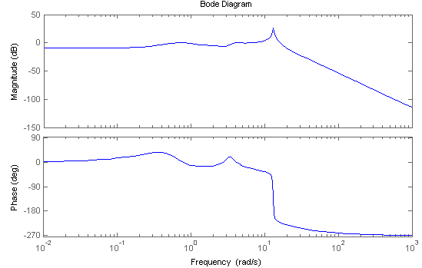
Without
compensator
With
compensator

Slide 9
Nyquist mapping
When creating a Nyquist plot, we map points along the imaginary axis through
The loop transfer function, L(s). The magnitude is:
$$\left|L(s)\right|=\frac{\prod_{k=0}^{m}{(s−z_{k})}}{\prod_{i=0}^{n}{(s−p_{i})}}, where s=jω.$$
Note that the magnitude of the mapping will increase when s approaches
a pole. This will happen when s is near the poles on the imaginary axis.

Slide 10
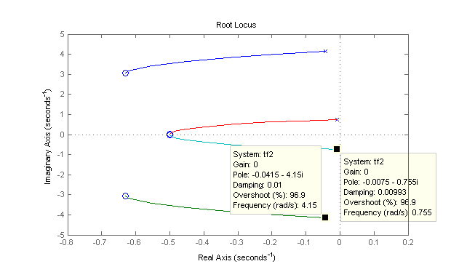
Nyquist Plot of compensator transfer function
When the poles of the compensator transfer function are examined it becomes apparent that they are very close to the imaginary axis. When the Nyquist Plot is generated, we can expect an increase in the magnitude of the mapping when s = jω is near the poles. The below root locus shows the location of the poles.

Slide 11
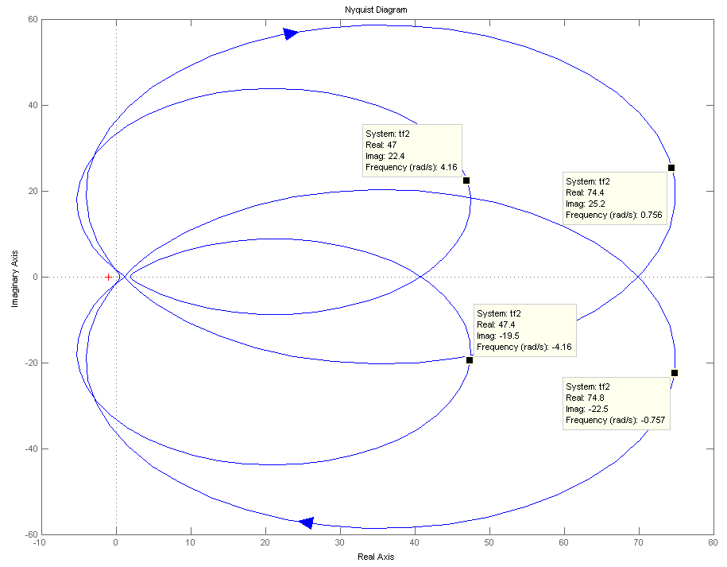

Slide 12
EE370L Lessons
EE370 taught the students some valuable engineering methods. The subject of control systems has fascinating applications, as demonstrated by this apropos problem.
Unfortunately, this understanding of engineering requires work, as most students will admit.

