Slide 1
M-ary signaling with error counting EE 460L
By
Jason Silic
Mario Valles

Slide 2
Purpose
Is to be able to transmit more than one signal through a single channel using TIMS.
This would be done by multiple amplitude signaling. Also know as multiple amplitude signaling or M-ary.
Also, to check the errors that might happen by with noise and/or signal distortion.

Slide 3
Roles
Jason Silic
Create the idea
Make the schematic
Circuit
Mario Valles
Help with the circuit
Lab report
Presentation

Slide 4
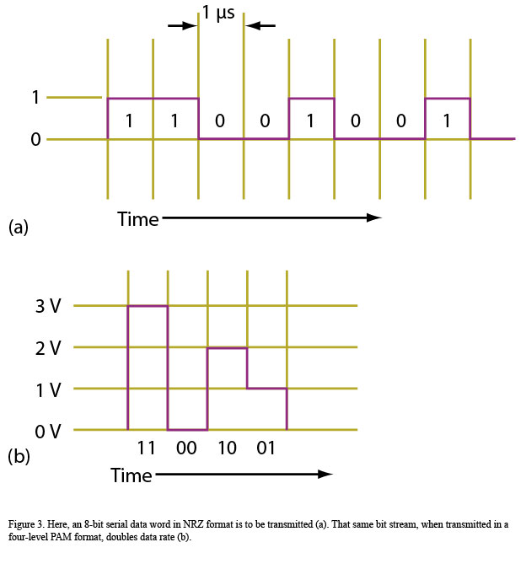
Diagrams
Figure 1(a) regular binary sequence
Figure 1(b) as an M-ary with M = 4 = 2^2.
00, 01,10, 11 on (b)

Slide 5
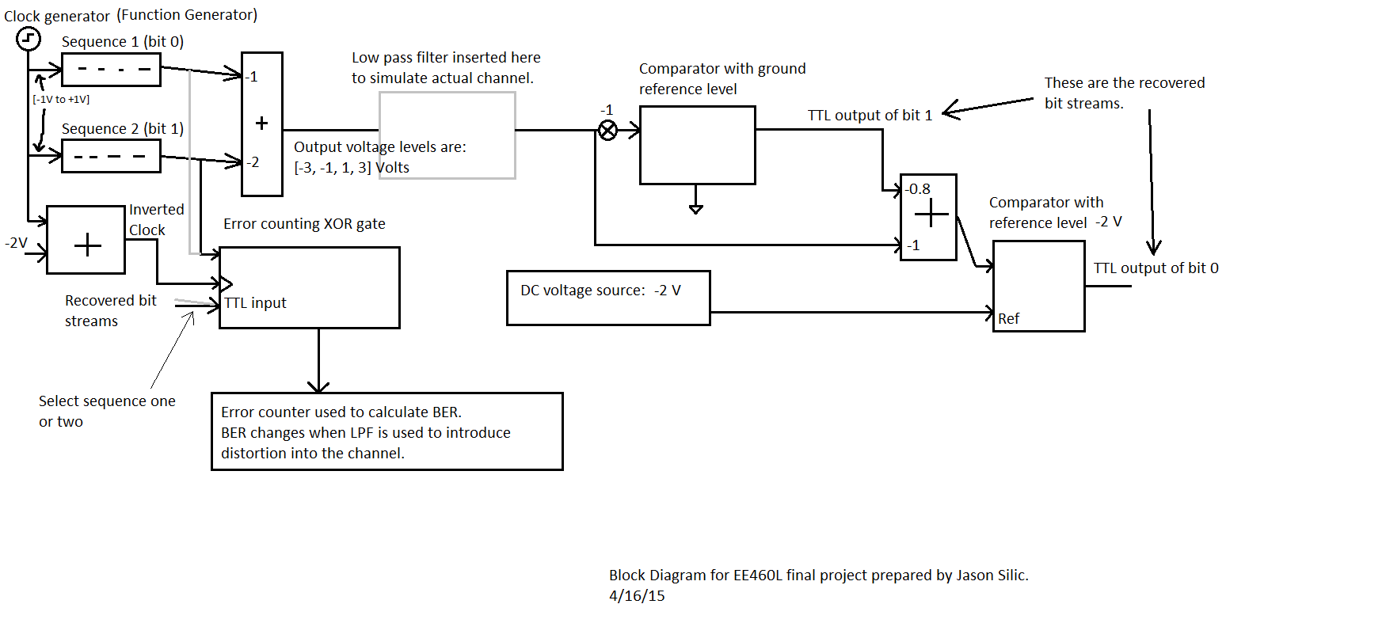

Slide 6
Connections

Slide 7
Connection (2)

Slide 8
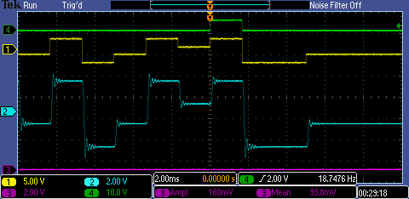
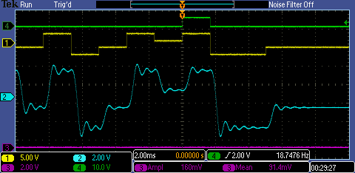
Different cut off frequencies
This frequencies were to simulate actual signals

Slide 9
Retract the original signals

Slide 10
Showing Both signals and M-ary

Slide 11
M-ary only

Slide 12
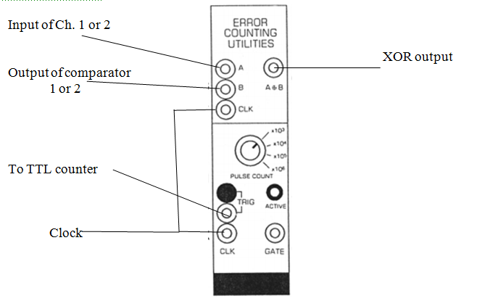
Counting error
We used this error counting in the TIMS machine and the error counting utility

Slide 13
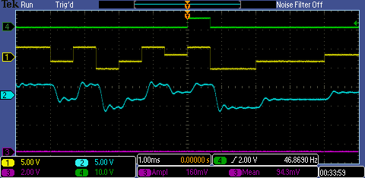
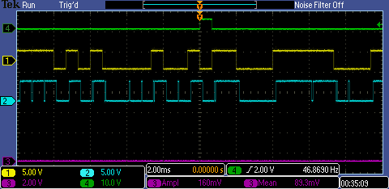
Results
For the following 1.5kHz

Slide 14
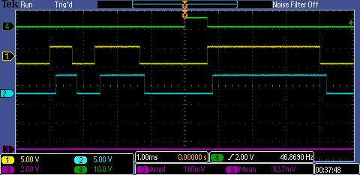
Error Discussion
The reason the XOR gate gave error was because of the delayed signal of the channel
Here we compare the recover signal with ther original

Slide 15
Error counting
The clock frequency was increased to 2.5 kHz. For these experiments the XOR gate counted errors for 10^4 clock periods.
At the first filter cutoff frequency we tried there were 625 errors in sequence 2, and 1563 errors in sequence 1. The reason for this is that sequence 1 has less "margin."
At a lower filter cutoff frequency there were 2180 errors for sequence 2 and 5936 errors for sequence 1. The low pass filter gets rid off the high frequencies which make the signal become more sinusoidal. This causes a lot more errors.

Slide 16
Encountered Problems
The problems encountered were :
Insufficient TIMS tools
Insufficient Time to finish in one day
Solution
Come next Wednesday to finish

Slide 17
Conclusion
The M-ary transmission is great because it saves channels and can use the same bandwidth.
The problem is it has a more complicated receiver and transmitter.
Another problem is that more power is use and more errors are created.
The probability of get an error increases since now there will be no only zero and one, but M numbers.

